Slide 1
Content Analysis (Part I)
Week 7 Lecture
Becoming a Political Researcher (POL2017)

Slide 2


Politics Research Seminar Series
Democratizing Political Parties: Experiences of Political Participation and Efficacy
(with Christopher Carter)
Matthias Poertner (Assistant Professor, LSE)
Wednesday 13th March 2024
1.15pm – 2.45pm
4.76 Henry Daysh Building
In representative democracies, political parties play a central role in linking voters to the state. Yet, in many young democracies, parties often fail to fulfil this key responsibility, providing neither accountability for poor politician performance nor effective and accurate representation of citizens' preferences. The inability of parties to form strong and enduring connections with voters provides a fertile ground for the emergence of non-democratic ideas and politicians. Using evidence from the case of Ecuador, a country with an exceptionally weak party system, this paper examines when otherwise weak parties form enduring ties with voters. We first highlight two central challenges to parties in Ecuador and beyond: low trust in and engagement with the political system and control of parties by entrenched, personalistic leaders, or caudillos. Drawing on evidence from a field experiment with Ecuadorian voters and a well-known political party, we find that parties can address both challenges by providing voters an opportunity to participate in defining the party's platform. Such participation increases voters' sense of efficacy, their political interest, and their support and trust in the political party and its leaders. The results shed light on a relatively low-cost way that discredited political institutions might be strengthened to prevent democratic erosion.

Slide 3


Slide 4
Surveys recap
Part I
What are surveys and what are they used for?
Variables and measurement
Designing surveys, question design
Part II
Who do we survey? (sampling)
How can we ask questions? (survey mode)
Practical tips for conducting surveys
Primary and secondary data

Slide 5
Coming up
This week
What is content analysis?
Types of content analysis
Case selection
Labelling our content
Validity and reliability
Next week
Where to get content
Doing our own content analysis
Examples in academic research

Slide 6
This week
Halperin & Heath (2020), Chapter 14 Textual Analysis, pp.373 – 388
Bryman, Social Research Methods, Chapter 13: Content analysis, pp.295-307
Read from section: ‘What is to be counted?’ to the end of the chapter
Matejova (2023) Framing Environmental Disasters for Nonviolent Protest: A Content Analysis. Environmental Communication, 17(4), 407-420.
Seminar questions:
What is content analysis, and what types of content can we examine?
How does validity and reliability apply to content analysis research?
What are the similarities and differences between qualitative and quantitative content analysis?

Slide 7
What is content analysis?

Slide 8



What is content analysis?
‘a research technique for making replicable and valid inferences from texts (or other meaningful matter) to the contexts of their use’ (Krippendorf, 2004: 18)
‘a method for describing the meaning of qualitative material in a systematic way’ (Schreier, 2012: 1)
‘the systematic analysis of textual information’ (Halperin & Heath, 2020: 373)

Slide 9
Related methods
We can analyse texts/documents using:
Content analysis
Quantitative and qualitative
Discourse analysis
Some common features with qualitative content analysis
Quantitative/Computational text analysis
Quantitative content analysis at scale using computational tools
Discourse analysis
Computational text analysis
Content
analysis

Slide 10
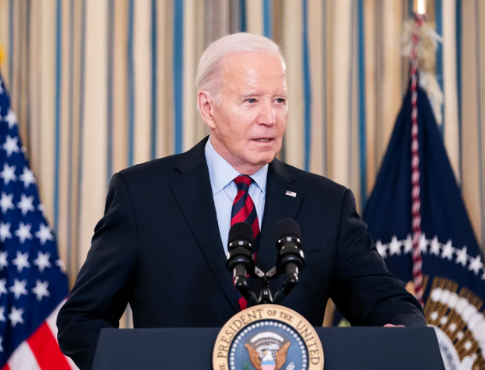






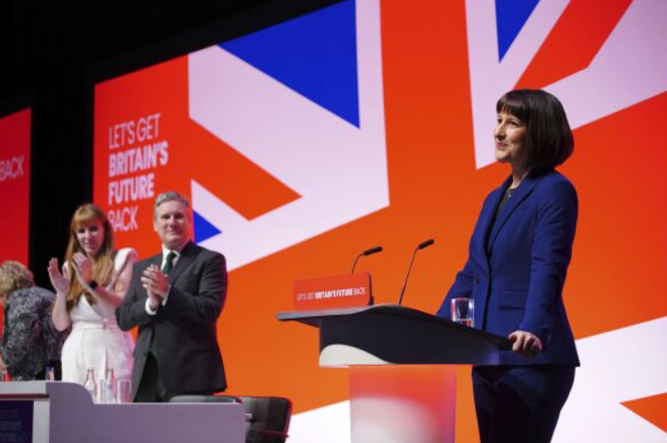

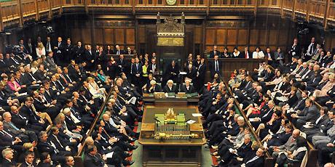
What content can we analyse?

Slide 11
What content can we analyse?
Audio-visual
Interviews
Campaign ads
Conference speeches
Posters
Film
TV programmes
War photography
Text
Speeches
Social media posts
News reports
Manifestos
Legislation
Policy documents
Campaign materials

Slide 12

(1999)

Slide 13



Slide 14
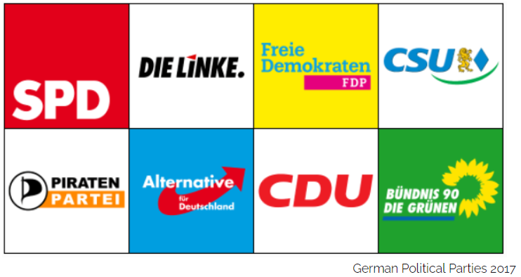
Casiraghi et al. (2023) - logos used by 308 political parties in 35 democracies
Left-right ideology
Political/country context
Party age

Slide 15
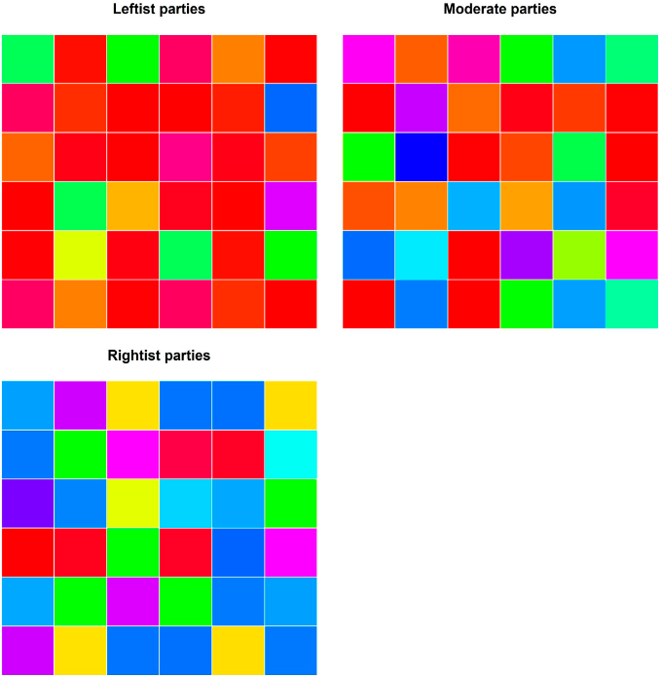
Source: Casiraghi et al. (2023)

Slide 16
What content can we analyse?
Audio-visual
Interviews
Campaign ads
Conference speeches
Posters
Film
TV programmes
War photography
Text
Speeches
Social media posts
News reports
Manifestos
Legislation
Policy documents
Campaign materials

Slide 17
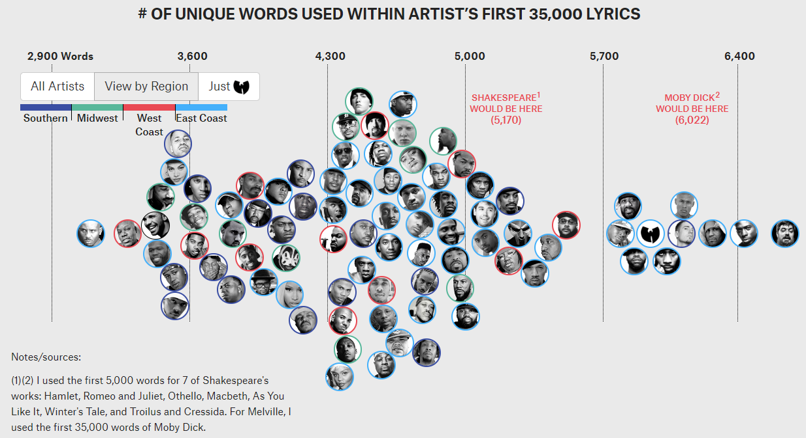

Slide 18
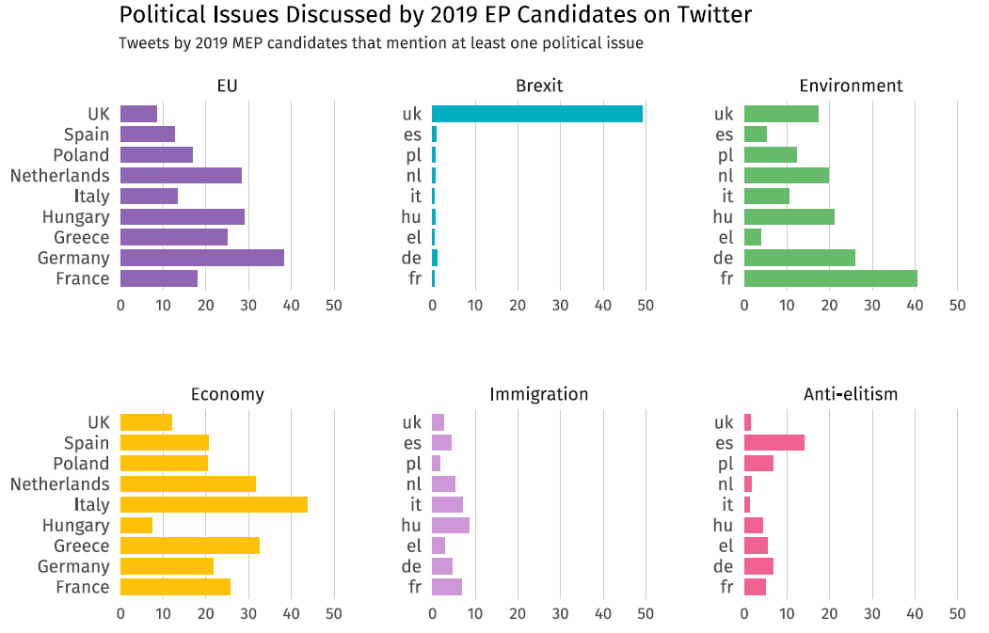
% of Tweets that mentioned at least one issue

Slide 19
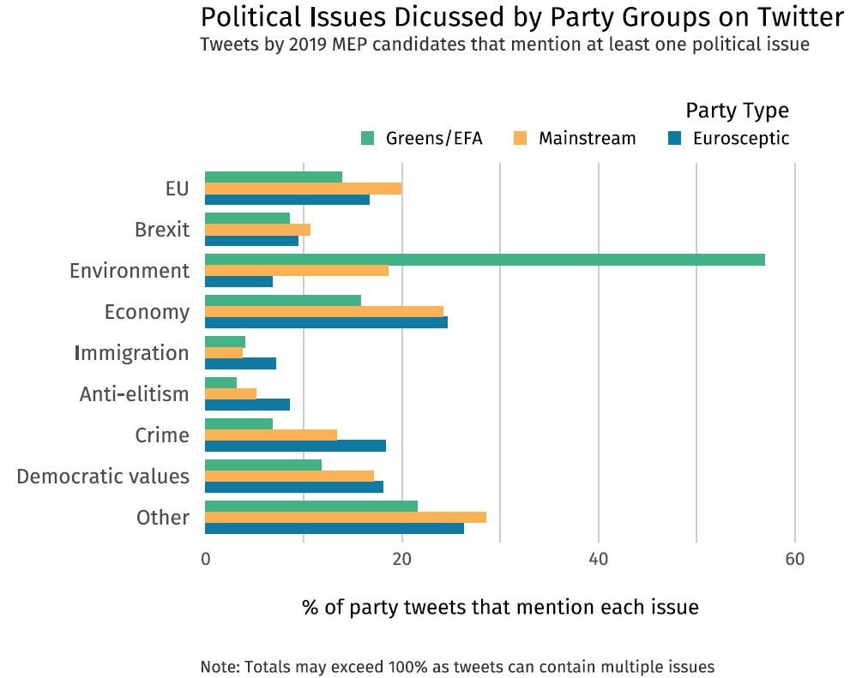

Slide 20
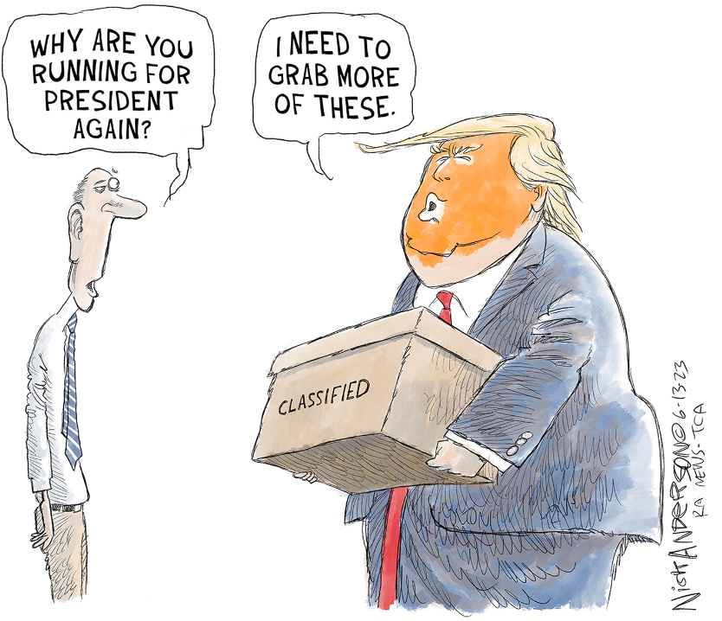

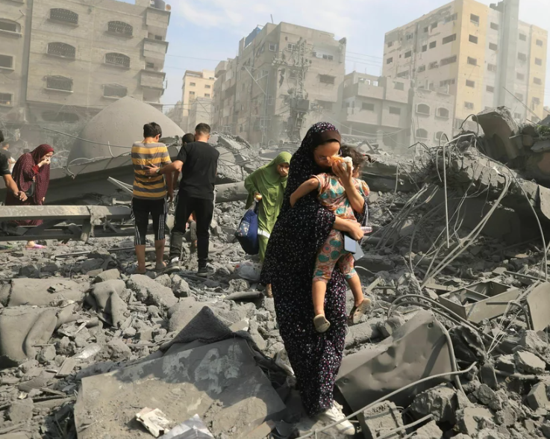
What questions can we ask?
How do political cartoons represent politicians?
How have Labour party manifestos changed over time?
How are the effects of war portrayed by the BBC?

Slide 21
What questions can we ask?
With content analysis we can ask about:
Content of a population of texts
Content of a sample of texts, to infer about a population
Influence of external factors on a text’s content
We can’t ask about
Influence of texts on attitudes and behaviour
- Surveys, interviews, focus groups

Slide 22
Strengths & Limitations
Strengths
Can study huge variety of topics
Can use multiples types of content
Unobtrusive method
Interviewer bias
Social desirability bias
Data on hard to access populations
Decision makers
Small or vulnerable groups
Limitations
Can’t study downstream effects
Influence on attitudes and behaviour
Availability of documents
Access
Survivorship bias
Researcher/coding bias

Slide 23
Summary
Content analysis:
Systematic analysis of texts or other media
Can analyse a wide variety of documents
Across huge range of issues
Unobtrusive method of data collection
Can examine otherwise inaccessible subjects
Can’t explore subsequent effects of the content

Slide 24
Types of content analysis

Slide 25
Types of content analysis
Quantitative
Positivism
Validity, reliability
Replicable
Manifest content
Qualitative
Interpretivism
Plausibility
Latent content

Slide 26
Quantitative content analysis
Objective, systematic approach to studying content
Focus on surface level, manifest observable features
Positivism
Validity, reliability, replicability
Questions about: How often? How many?

Slide 27
Qualitative content analysis
Subjective approach to studying content
Focus on deeper, latent meaning of content
Interpretivism
Plausibility
Questions: In what context? How is it used?

Slide 28



Do you think the following research questions would be better suited to quantitative or qualitative content analysis, and why?
How do different governments make use of national myths and cultural symbolism in their official press releases?
What types of political issues have been referenced in Academy Awards acceptance speeches?
How often have the concepts of democracy and human rights been referenced in member state’s speeches to the UN?

Slide 29
Types of content analysis
Can use content analysis as a quantitative or qualitative method (or both!)
Can also approach categorising texts in different ways:
Inductive
Deductive

Slide 30
Types of content analysis
Inductive coding
Read texts carefully, and create coding categories as we go
Open/grounded coding
Does item fit with existing code? If not, create new category
Deductive coding
Define pre-set categories beforehand that will be coded
Based on theory or existing research
Closed coding

Slide 31
Example
Lets say we are conducting a research project about how mainstream media bias is discussed on social media.
We pick a show and social media platform to examine:
- BBC Question Time, Twitter/X
And we want to find out what types of accusations of bias get made against the programme.

Slide 32
Inductive: What categories could we come up with to label the following texts?
@bbcquestiontime very biased programme with a very biased host from a very biased broadcaster with a hand picked audience
#bbcqt fuck off dimbleby you biased idiot telling licence payers to shut up.
#bbcqt the most biased right wing panel ever assembled for question time
Only person that hasn't been a chance to speak is a labour candidate (owen) on the NHS #bbcqt. He only spoke in response..biasness
@bbcquestiontime Turned off! Right wing pro-Brexit bias of the BBC in full effect. Two CON and one UKIP! No Lib. No Greens. Disgraceful!

Slide 33
Example
Potential categories
Type of bias
Left/right wing
Party bias
Pro/anti EU
Region?
Object of bias
Audience/questions
Panel selection
Host
Location
BBC
Biased in which direction?
Zero, one, or multiple accusations?

Slide 34
Summary
Quantitative
Positivism
Validity, reliability
Manifest content
Qualitative
Interpretivism
Plausibility
Latent content
Inductive and deductive approaches

Slide 35
Evaluating content analysis

Slide 36
Evaluating content analysis
Qualitative content analysis
Plausible categories
Explanation of coding decisions
For all types of content analysis
We can make our raw data and coding scheme publicly available

Slide 37
Evaluating content analysis
Quantitative content analysis
Validity
internal validity
external validity
Reliability
intra-coder reliability
inter-coder reliability

Slide 38
Validity
Internal validity
Does our coding capture the concepts we are interested in?
External validity
How generalisable are our findings to other contexts?

Slide 39

Reliability
Intra-coder reliability
Does the same person code the same items consistently over time?
Inter-coder reliability
Do different people code the same items in a similar way?

Slide 40
Reliability
Measures of inter-coder reliability
Percentage agreement
What % of items were coded in the same way by both coders?
Takes values between 0-100
Reliability coefficients
e.g. Krippendorf’s Alpha
Measure of observed disagreement, corrected for level of disagreement expected by chance
Takes values between -1 and 1

Slide 41
Reliability
Measures of reliability
 | Item 1 | Item 2 | Item 3 | Item 4 | Item 5 | Item 6 | Item 7 | Item 8 | Item 9 | Item 10
Coder 1 | 0 | 1 | 0 | 0 | 0 | 1 | 0 | 0 | 0 | 1
Coder 2 | 0 | 1 | 0 | 0 | 0 | 1 | 0 | 0 | 0 | 1
Agreement = 100%
Krippendorf’s Alpha = 1

Slide 42
Reliability
Measures of reliability
 | Item 1 | Item 2 | Item 3 | Item 4 | Item 5 | Item 6 | Item 7 | Item 8 | Item 9 | Item 10
Coder 1 | 0 | 1 | 1 | 1 | 0 | 1 | 1 | 0 | 0 | 1
Coder 2 | 0 | 0 | 0 | 0 | 1 | 1 | 0 | 0 | 0 | 1
Agreement = 50%
Krippendorf’s Alpha = 0.04

Slide 43
Reliability
Measures of reliability
 | Item 1 | Item 2 | Item 3 | Item 4 | Item 5 | Item 6 | Item 7 | Item 8 | Item 9 | Item 10
Coder 1 | 0 | 0 | 0 | 0 | 0 | 1 | 0 | 0 | 0 | 0
Coder 2 | 0 | 0 | 0 | 0 | 0 | 0 | 0 | 0 | 0 | 0
Agreement = 90%
Krippendorf’s Alpha = 0

Slide 44
Summary
Qualitative content analysis
Plausible categories
Explanation of coding decisions
Quantitative content analysis
Internal and external validity
Intra and inter-coder reliability

Slide 45
Join the Vevox session
Go to vevox.app Enter the session ID: 196-472-727 Or scan the QR code
For each of the following examples, please code the sentiment or emotional tone of the text as either:
"Positive", "Negative", or "Neutral"

Slide 46
Stages of a content analysis

Slide 47
Stages in content analysis
Research questions/hypotheses
Case selection
Units of analysis
Categories
Coding
Analysis

Slide 48
1. Research questions
What do we want to find out?
What are our main concepts of interests?
What variables do we want to measure?
Will influence our:
Research approach
Target population & sampling
Coding categories

Slide 49
2. Case selection
What type of sources?
Over what time period?
How many?
What documents can we access? What is missing?
Search for documents is a balance between:
Too broad (may include irrelevant cases)
Too narrow (may miss relevant cases)

Slide 50
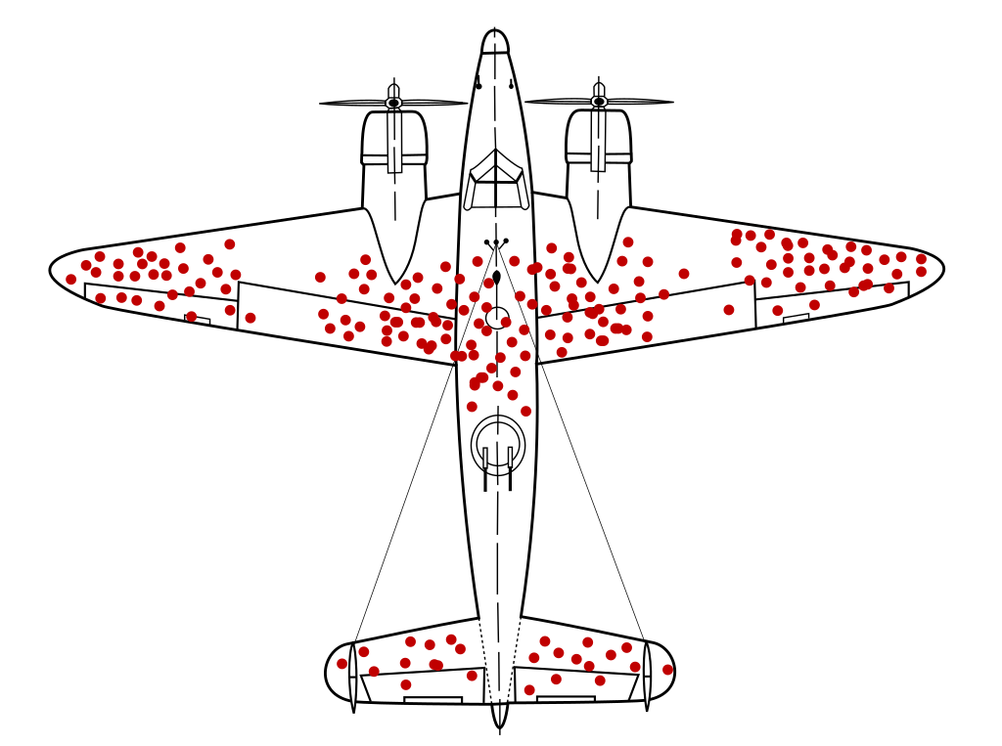

Slide 51
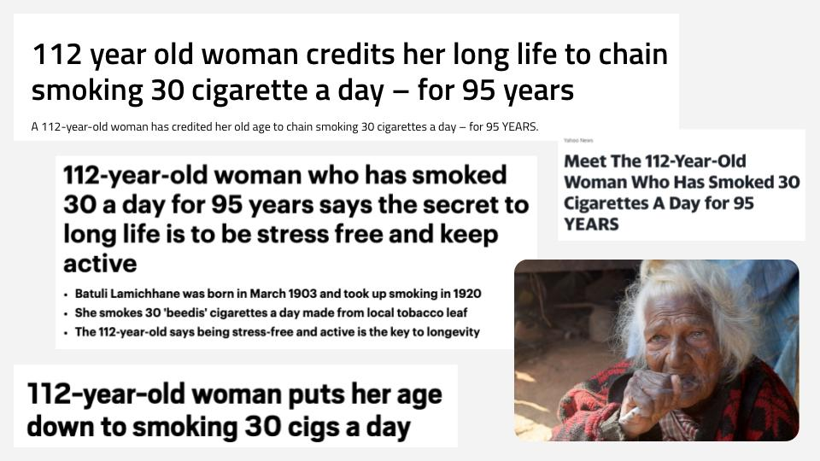

Slide 52
Example: Research question
Lets say we are conducting a research project about how mainstream media bias is discussed on social media.
Lets narrow our topic down:
Specific show: BBC Question Time
Specific platform: Twitter/X
Then create an initial research question:
What percentage of Tweets about BBC Question Time contain accusations of bias against the programme?

Slide 53
Example: Case selection
RQ: What percentage of Tweets about BBC Question Time contain accusations of bias against the programme?
Target population: All Tweets posted about BBCQT
What search queries could we use to try and identify Tweets about BBC Question Time to include in our study?
Keywords, time-periods, hashtags, accounts

Slide 54
Example: Case selection
What search queries could we use to try and identify Tweets about BBC Question Time to include in our study?
Accounts: Tweets that mention @bbcquestiontime
Hashtags: #bbcqt
Keywords: ‘BBC Question Time’
When: All tweets? On days episodes aired? During broadcast?
Is our search too broad, or too narrow?
Can we access our full population of cases?

Slide 55
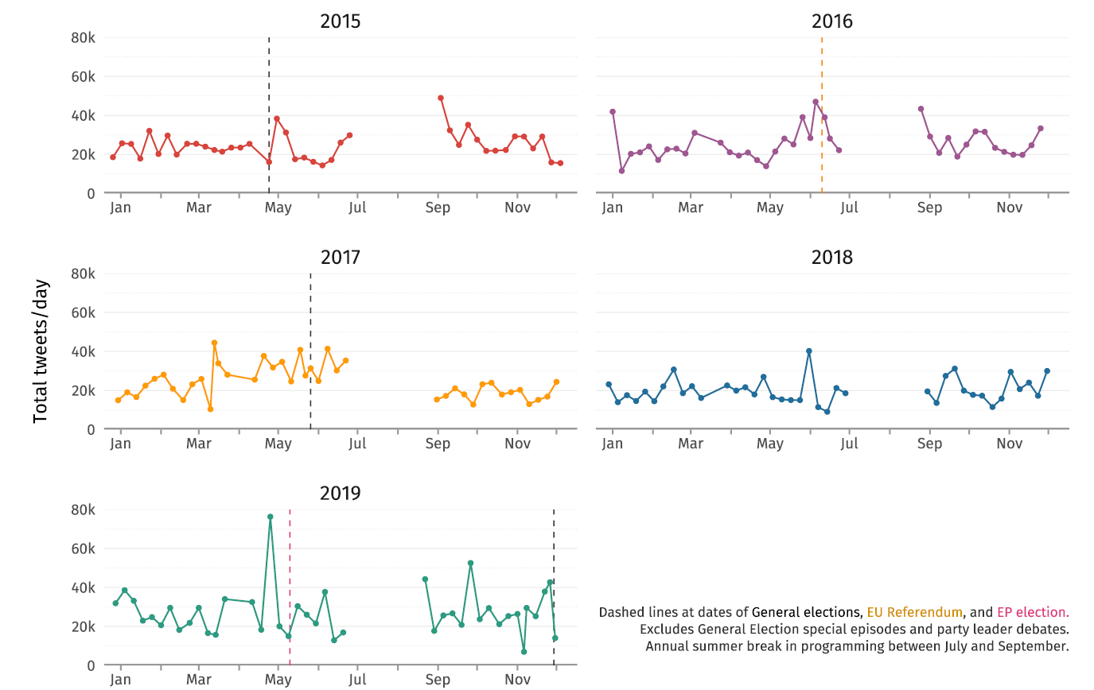

Slide 56
2. Case selection
If our population of cases is large, we may need to analyse smaller sample of cases instead
Sampling techniques: Random, non-random sampling
Quantitative: Larger number of cases
Qualitative: Smaller set of cases

Slide 57
3. Units of analysis
What segments of the text are we interested in?
Entire document; Characters/people; Themes; Paragraphs; Sentences; Words
Quantitative
Often divides texts into smaller units
Qualitative
Often larger units, or documents in their entirety

Slide 58
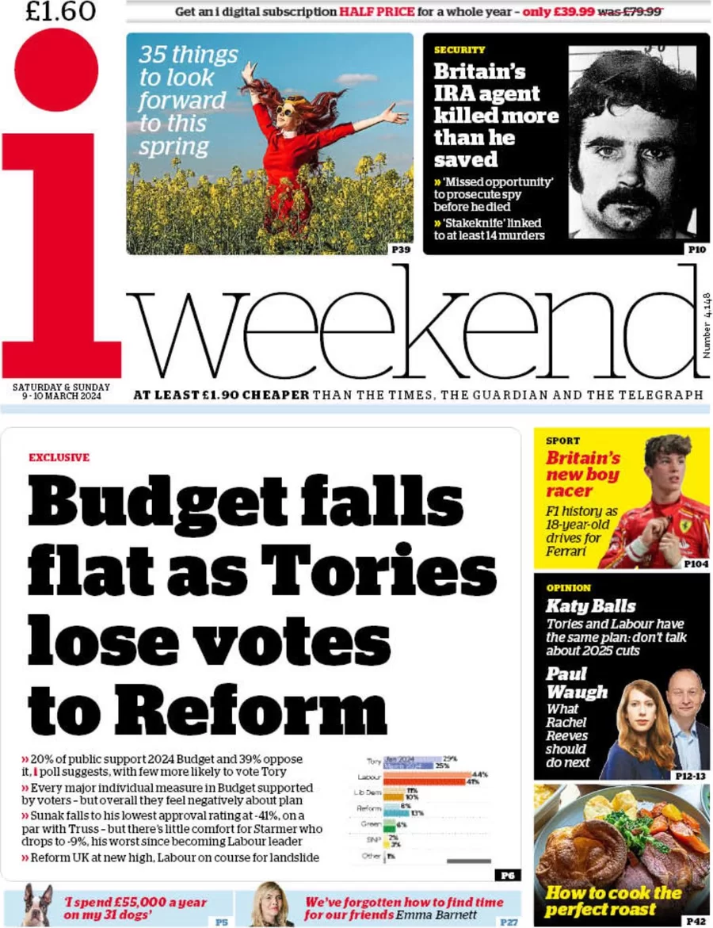
Lets say we want to conduct a content analysis of newspaper coverage.
What potential units of analysis could we split our content into?

Slide 59
3. Units of analysis
Newspapers
Front pages ➔ Articles ➔ Paragraphs ➔ Sentences ➔ Headlines
Manifestos
Manifesto ➔ Sentence ➔ Quasi-sentence ➔ Words
Parliamentary Speeches
Debates ➔ Speakers ➔ Paragraphs ➔ Sentences ➔ Words

Slide 60
4. Categories
What will we examine our documents for?
Identify relevant features to focus on:
What concepts are we interested in analysing?
What variables are we trying to measure?
We categorise texts inductively or deductively?

Slide 61
4. Categories
Document variables
What type of document?
Who wrote it?
When, where?
Main content
Split into our units of analysis
Can categorise each unit according to our variables/concepts

Slide 62
4. Categories
What will we examine our documents for?
Salience
- How often is issue ‘X’ mentioned?
Sentiment
- What is the emotional tone of the text?
Framing
- In what context does the text mention issue ‘X’?
Intensity
- How strongly does the text support/oppose issue ‘X’?
Co-occurrence
- What terms are also mentioned alongside issue ‘X’?

Slide 63
4. Coding
How will we identify whether a unit belongs in our category of interest?
Coding scheme
Set of instructions on how to assign codes to each category
Code sheet
Where we enter information on how we labelled each document

Slide 64
4. Coding
Common coding methods
Keyword search
Dictionary search
Qualitative coding

Slide 65

4. Coding
Example: We want to find out how often Palestine and Israel are mentioned in online news stories
Keyword search
See how often the terms: “Israel” and “Palestine” appear in the website text

Slide 66
4. Coding
Example: We want to find out how often Palestine and Israel are mentioned in online news stories
Dictionary search
Create a dictionary, or group of related words for each category.
Israel = “Israel”, “Jerusalem”, “Tel Aviv”
Palestine = “Palestine”, “West Bank”, “Gaza”, “Rafa”

Slide 67
4. Coding
Example: We want to find out how often Palestine and Israel are mentioned in online news stories
Qualitative
Carefully read each story to see whether either territory is mentioned.
Can capture any indirect mentions or references

Slide 68
4. Coding
Coders
Researcher/Expert coding
Multiple trained coders
Crowd-sourced
Model based

Slide 69
Sentiment Analysis
 | Text | Brian
1 | Teardrops on My Guitar | Negative
2 | Baby, Don’t You Break My Heart Slow | Negative
3 | We Are Never Ever Getting Back Together | Negative
4 | It’s Nice to Have a Friend | Positive
5 | Welcome Distraction | Neutral
6 | A Monster In My Closet | Negative
7 | This is Why We Can’t Have Nice Things | Negative
8 | I Knew You Were Trouble | Negative
9 | Live For The Little Things | Positive
10 | Don’t Hate Me For Loving You | Neutral

Slide 70
Codebook
Variable name: Sentiment
Labels: Positive, Negative, Neutral
Assign each text a label based on its sentiment or emotional tone, using of the three following options: positive, negative, or neutral.
The baseline for any text is ‘neutral’, if the sentiment is unclear then also use this category as a default.
Note: The use of sarcasm and irony should always be coded as negative.

Slide 71
Sentiment Analysis
 | Text | Brian | Coder 2
1 | Teardrops on My Guitar | Negative | Neutral
2 | Baby, Don’t You Break My Heart Slow | Negative | Neutral
3 | We Are Never Ever Getting Back Together | Negative | Negative
4 | It’s Nice to Have a Friend | Positive | Positive
5 | Welcome Distraction | Neutral | Positive
6 | A Monster In My Closet | Negative | Negative
7 | This is Why We Can’t Have Nice Things | Negative | Negative
8 | I Knew You Were Trouble | Negative | Negative
9 | Live For The Little Things | Positive | Positive
10 | Don’t Hate Me For Loving You | Neutral | Neutral

Slide 72
 | Text | Brian | Coder 2 | Agreement
1 | Teardrops on My Guitar | Negative | Neutral | No
2 | Baby, Don’t You Break My Heart Slow | Negative | Neutral | No
3 | We Are Never Ever Getting Back Together | Negative | Negative | Yes
4 | It’s Nice to Have a Friend | Positive | Positive | Yes
5 | Welcome Distraction | Neutral | Positive | No
6 | A Monster In My Closet | Negative | Negative | Yes
7 | This is Why We Can’t Have Nice Things | Negative | Negative | Yes
8 | I Knew You Were Trouble | Negative | Negative | Yes
9 | Live For The Little Things | Positive | Positive | Yes
10 | Don’t Hate Me For Loving You | Neutral | Neutral | Yes
Agreement = 70%
Kripp Alpha = 0.54

Slide 73
4. Coding
Dictionary based sentiment analysis (old school)
“Don’t Hate Me For Loving You”
-1 -1 0 0 +1 0
Overall sentiment = -1 (Negative)

Slide 74
Sentiment Analysis
 | Text | Brian | Chat GPT
1 | Teardrops on My Guitar | Negative | Neutral
2 | Baby, Don’t You Break My Heart Slow | Negative | Neutral
3 | We Are Never Ever Getting Back Together | Negative | Negative
4 | It’s Nice to Have a Friend | Positive | Positive
5 | Welcome Distraction | Neutral | Positive
6 | A Monster In My Closet | Negative | Negative
7 | This is Why We Can’t Have Nice Things | Negative | Negative
8 | I Knew You Were Trouble | Negative | Negative
9 | Live For The Little Things | Positive | Positive
10 | Don’t Hate Me For Loving You | Neutral | Neutral

Slide 75
4. Analysis
Analyse and attach meaning to our data
What patterns or insights can we obtain from our data?
How does this relate to our research question?
Quantitative
Numerical data, coded across predefined variables
Inferences based on frequencies, salience, intensity of category
Qualitative
Identify concepts/themes that emerge within data
Use quotes/diagrams/narratives to present data

Slide 76
Summary
Stages of content analysis:
Research questions/hypotheses
Case selection
Units of analysis
Categories
Coding
Analysis

Slide 77
Reading Example
Matejova (2023)
Framing Environmental Disasters for Nonviolent Protest
Topic: How do political actors talk about environmental disasters in their aftermath?

Slide 78
1. Research Question
RQ1: What frames and tone dominate news coverage after environmental disasters?
RQ2: How do frames and tone vary by framing actor?
RQ3: How much space do specific framing actors get in news coverage after disasters?

Slide 79
2. Case selection
3 Environmental disasters:
2014 Mount Polly mine leak
2010 Deepwater horizon oil spill
2011 Fukushima nuclear disaster
Time, data, protest

Slide 80
2. Case selection
LexisNexis
Keyword search:
Mount Polley, Deepwater Horizon OR (BP AND oil spill), Fukushima
1 year post event
Canadian, US, German newspapers with high readership
Random sample of 537 texts

Slide 81
4. Categories
Frames
Responsibility, human interest, morality. . .
Tone
Successful, prepared, reliable, uncertain. . .
Framing actors
Activists, governments, corporations

Slide 82
3. Units of analysis & coding
Unit of analysis: full news article
Qualitative coding, deductive approach
Coders
2 trained coders, reliability metrics

Slide 83
6. Analysis
Activists rarely featured, used negative tone
Government frames varied by level of government
Corporations used positive tone
Media framing did not typically link events to wider environmental issues

Slide 84
Summary
This week
What is content analysis?
Types of content analysis
Case selection
Labelling our content
Validity and reliability
Next week
Where to get content
Doing our own content analysis
Examples in academic research

Slide 85
References
Casiraghi, M.C., Curini, L. and Cusumano, E. (2023) ‘The colors of ideology: Chromatic isomorphism and political party logos’, Party Politics, 29(3), pp. 463–474. Available at: https://doi.org/10.1177/13540688221080539.
Schreier, M. (2012) Qualitative content analysis in practice.
Krippendorff, K. (2004) Content analysis : an introduction to its methodology, 2nd Edition

